Slide 1
Annual Community Meeting
Review of the 2022 Season
Huntington Hills Swim and Racquet Club
March 30, 2023
7:30 pm
HH Community Library, DIx Hills

Slide 2
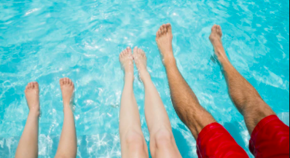
Welcome
Review of the 2022 Pool Season
7:30 PM
Half Hollow Hills
Community Library
Room 111- Lecture Room

Slide 3
Introduction of Board Members
Welcome new families to the neighborhood
Scope of 2022 Season
Financial Review & Collections
New Business and Capital Improvements
Facebook Page & Tentative Calendar
Open Forum

Slide 4
Introduction of Board Trustees
Shirley Vargas……..President
Toby Abel…………….Secretary
Ken Gold……………..Vice President
Prem Katyal………..Treasurer
Sue Gordon………….Trustee
Sara Lefkowitz…….Trustee
Lois Shewchuk…….Trustee

Slide 5
Welcome to the neighborhood!
TOBY A.
We welcome all new families who are now members of our neighborhood!
Introducing our new members at:
9 Westbourne Ln.
36 Woodmont Rd.
96 Wilmington Dr.
126 Wilmington Dr.
44 Elkland Rd.
23 Richbourne Ln.
9 Pembury Ct.
42 Woodmont Rd.
14 Elkland Rd. 39 Northcote Dr.
45 Elkland Rd.
5 Carry Ln.
Toby Abel, Welcoming Committee

Slide 6
Our 2022 summer season

Slide 7
2022
Club fully staffed all season
Members enjoyed club events, friends, and family time
New deck was welcomed by all
Old shrubs were removed and replaced to provide an updated look
Kitchen Reopened

Slide 8
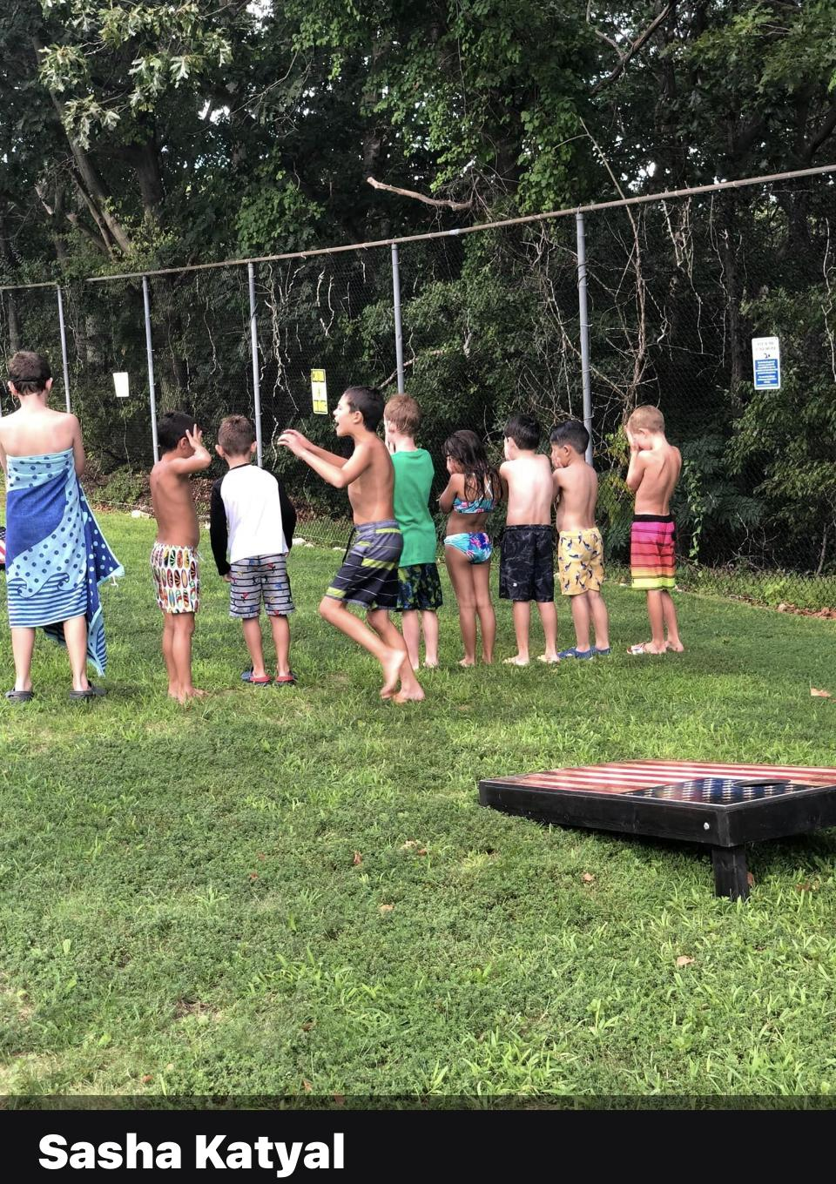
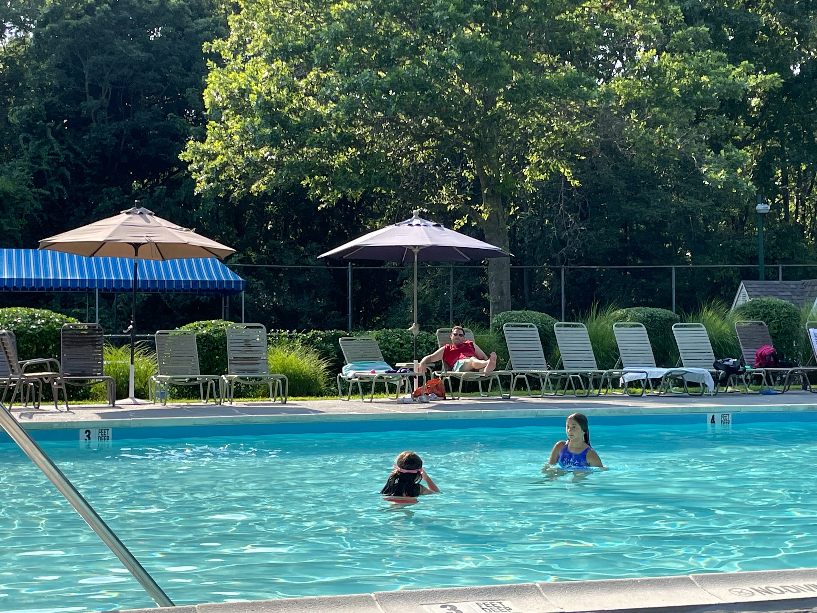
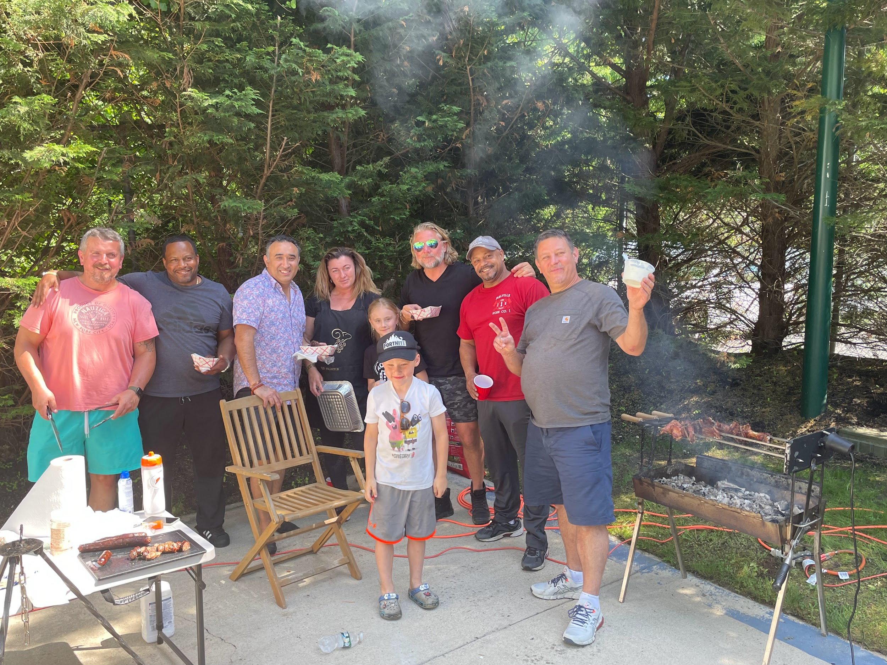
Summer events of 2022
Memorial Day* 4th of July * Labor Day CLosing

Slide 9
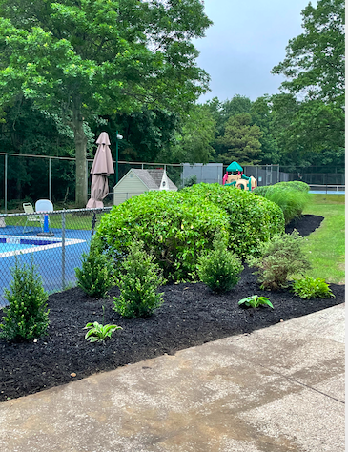
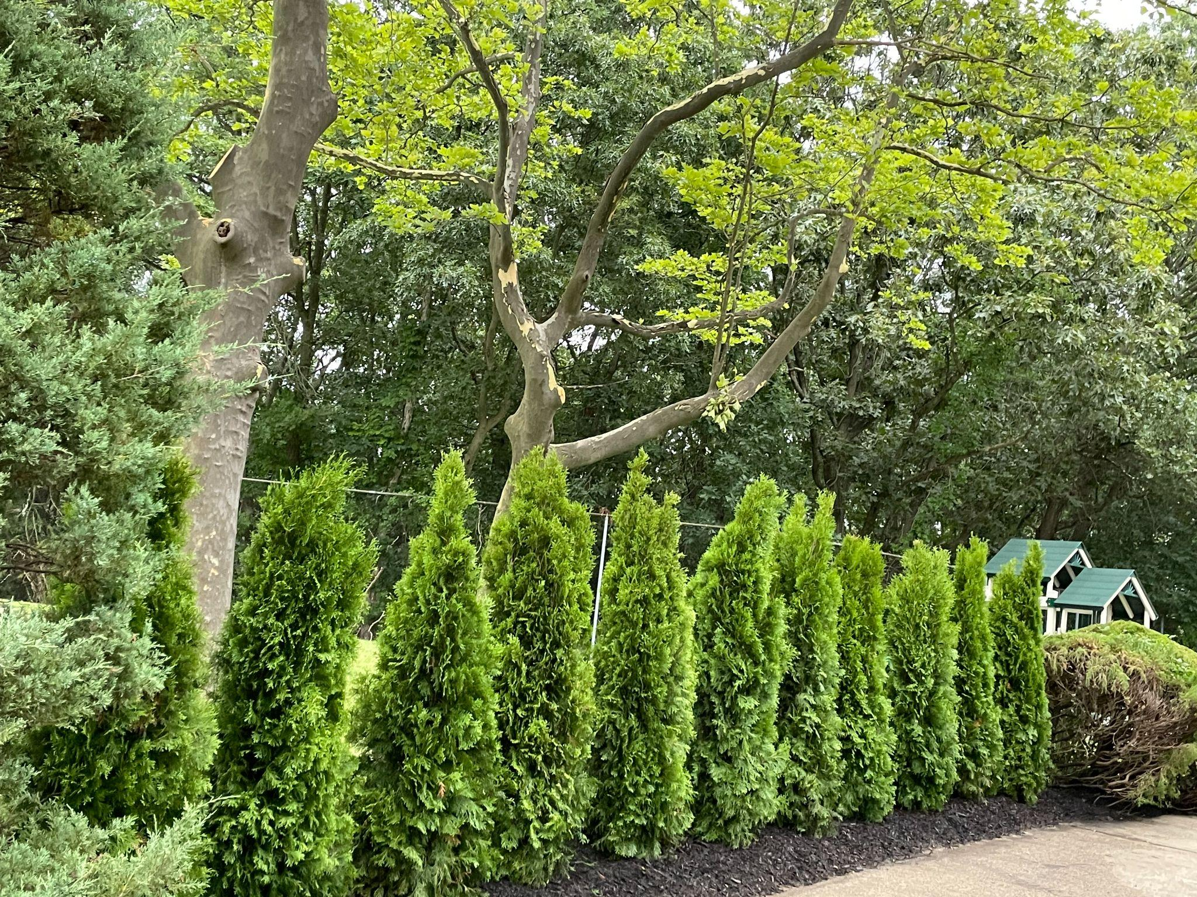
Bautistas Landscaping Co.

Slide 10
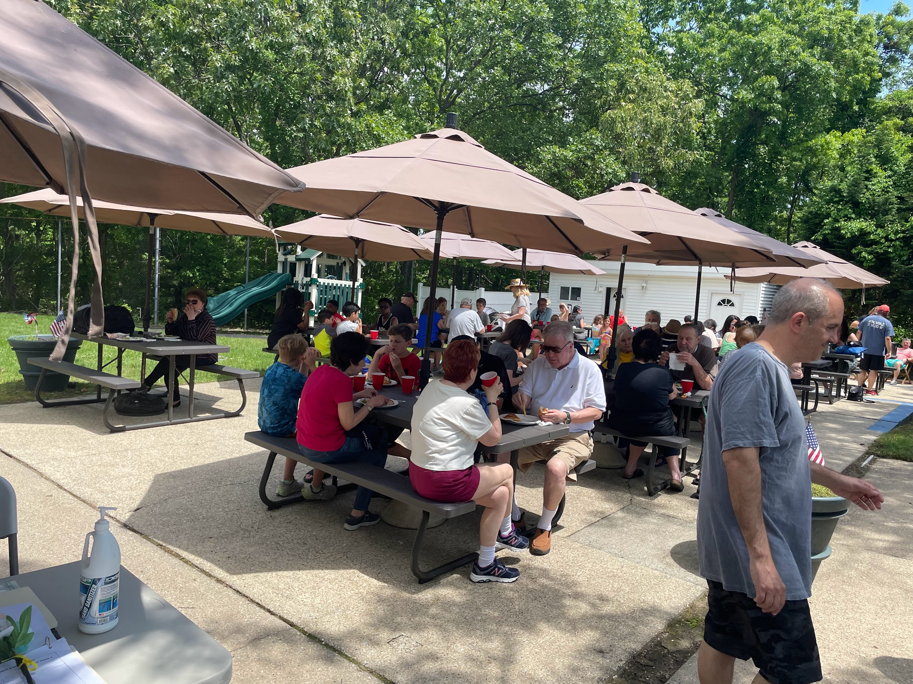
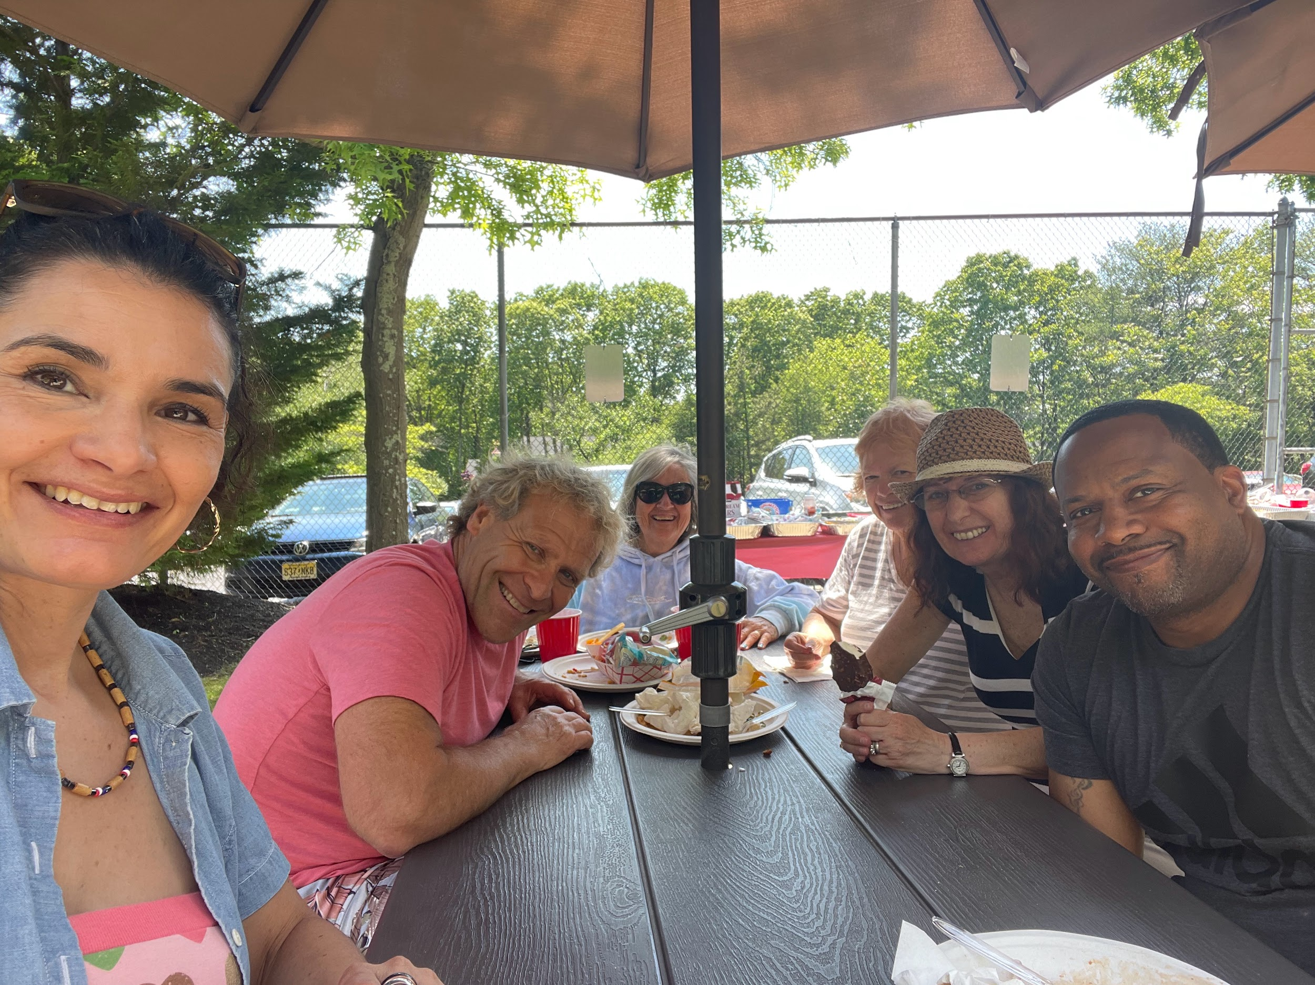
Events
Sara L.
2022

Slide 11
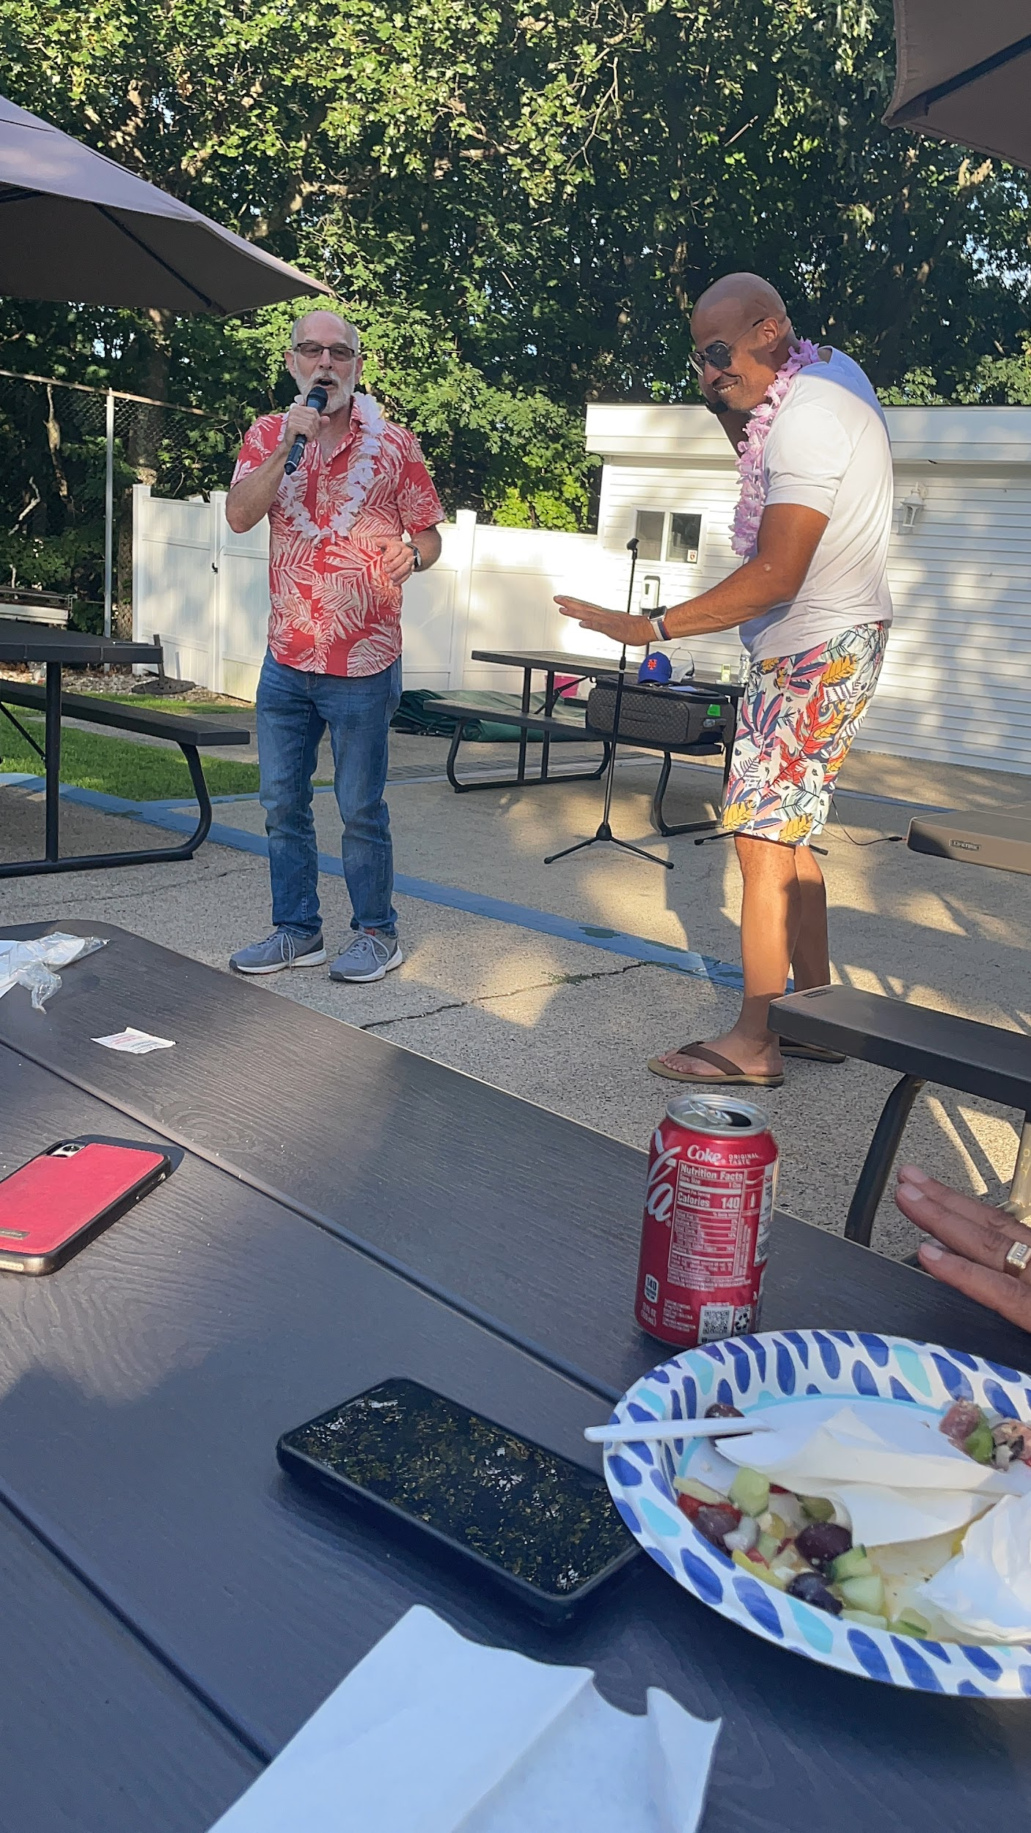
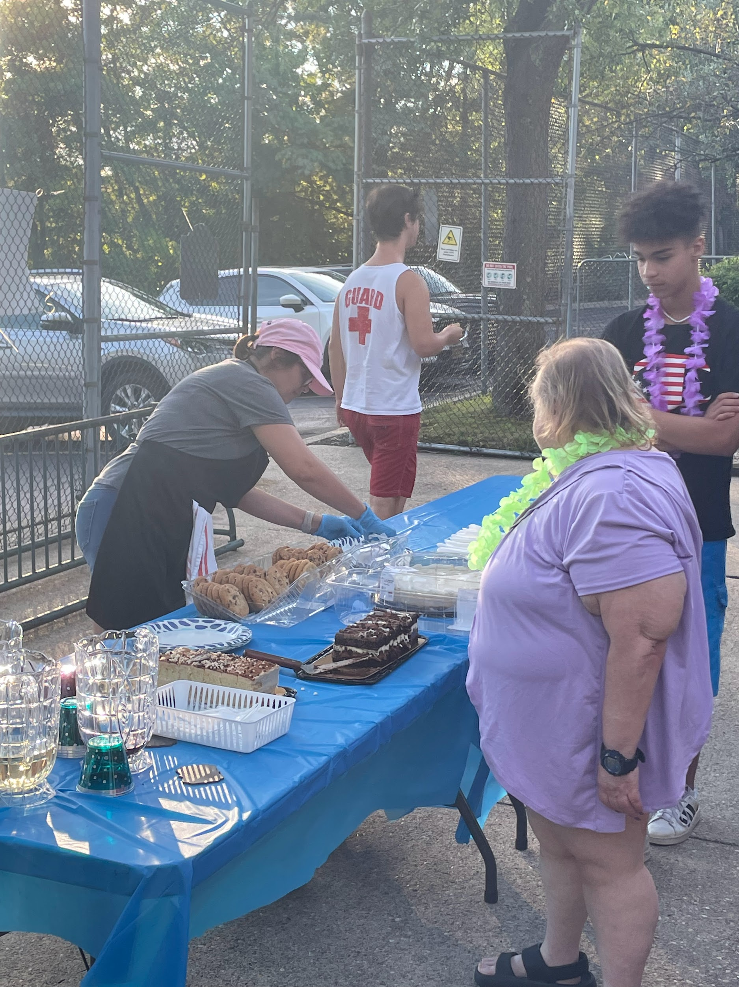

Slide 12
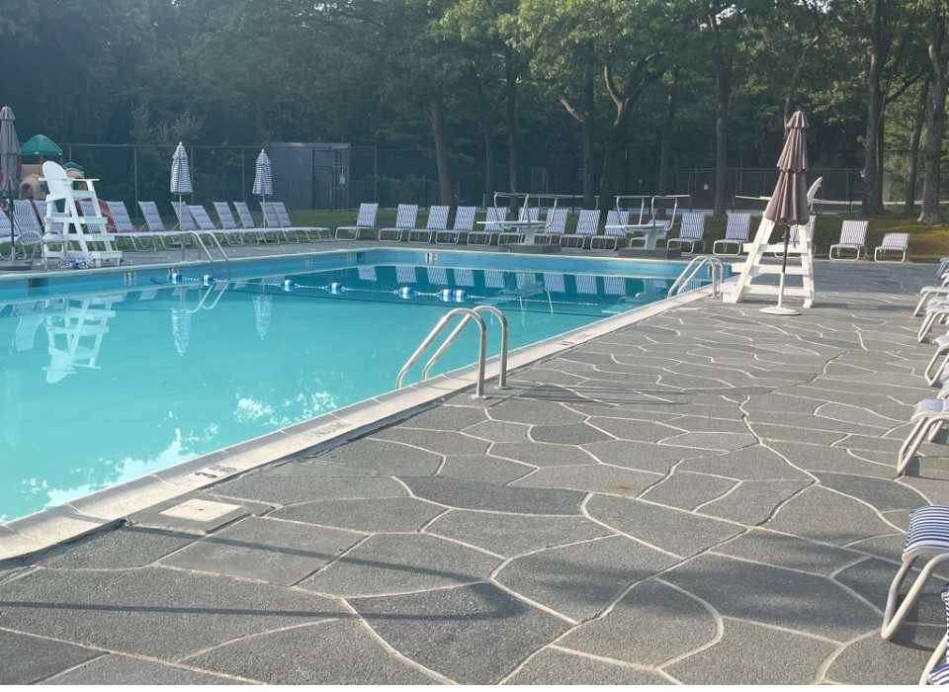
Renukrete, Inc.

Slide 13
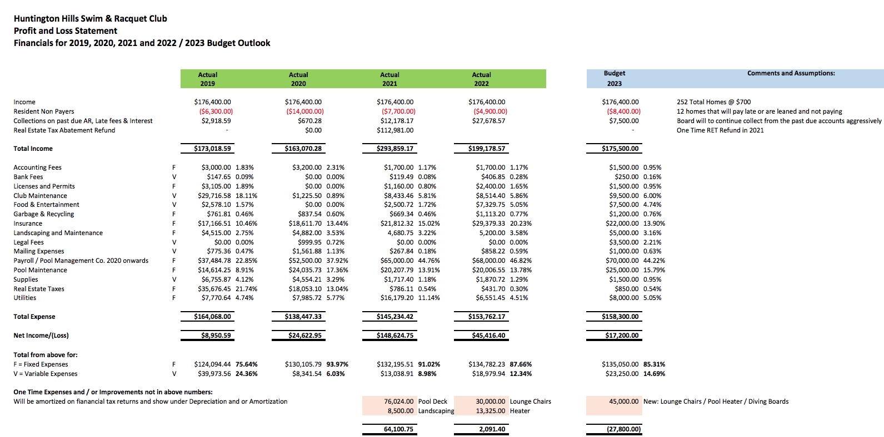
Financial Report, Prem Katyal- Treasurer
NEED UPDATING
and new deck umbrellas

Slide 14
Installation of new heater
Installation of new diving boards
New Lounge Furniture
New Matching Umbrellas
New secured doors for dumpster
For 2023….
Ken

Slide 15
COLLECTIONS
Lois and Dan Shewchuk

Slide 16
2022 Receivables & Collections
252
4
6
Annual dues: 700.00
Homes in membership
Small claims
Liens

Slide 17
Anticipated Expenses and Capital Improvements in 2023

Slide 18
Projected Capital Improvements
Tennis courts refacing
pickleball/tennis
Curb appeal
Picnic area enhancement
The bidding process will continue, still under discussion
Sue Gordon

Slide 19
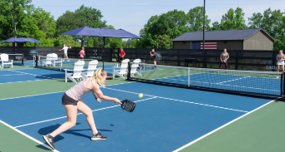
Capital Improvement #1: Existing Tennis Courts
Asphalt
Raising court by 1.5 inches
Install new fencing & access points
4 pickleball courts
Two tennis courts
Enhanced locking system
Handball court - additional pickle court
The bidding process will continue, still under discussion
Sue Gordon

Slide 20
Capital Improvement 2 and 3: Beautification
Curb appeal
Picnic area enhancement
The bidding process will continue, still under discussion
Sue Gordon

Slide 21
tentative timeline
Preparations for Opening Day Lunch
Install diving board
Install heater
April -May
May-June
Half days 3rd week of June
Now Open 7 days a week
September
End of June
July - Aug
Landscaping
Inspections
Grounds prep.
Fri-Sun open
4th of July event
Ice cream social
Family night
Family Fun Day
Closing of pools

Slide 22
WWW.HHPRC.CLUB
Please visit us at hhprc.club for more neighborhood information.

Slide 23
Looking for Committee members to help organize:
Toddlers & little ones weekly events:
Swimming lessons
Creative play
Social Events for all ages:
Middle school
Teens at the courts & pool
Pick - up games:
Pickleball
basketball
I
Social Media support:
Facebook
Instagram
uploads

Slide 24
Facebook page & Instagram handle:
Huntington Hills Swim & Racquet Club
As of May 15th 2022

Slide 25
Community Discussion
Members may address the board.
Thank you for your continued support.

Slide 26
Interested in joining the board in 2024?
Visit our website and contact us.

Slide 27
Thank you!
Do you have any questions? You can always email:
info@hhprc.club

